Slide 1
PnP Community Call – February 2015
aka.ms/OfficeDevPnP
aka.ms/OfficeDevPnPYammer
aka.ms/OfficeDevPnPGuidance
PnP Core Team

Slide 2

Agenda
Demos, demos, demos
Monthly highlights
Contributions and other topics
Roadmap and next steps

Slide 3
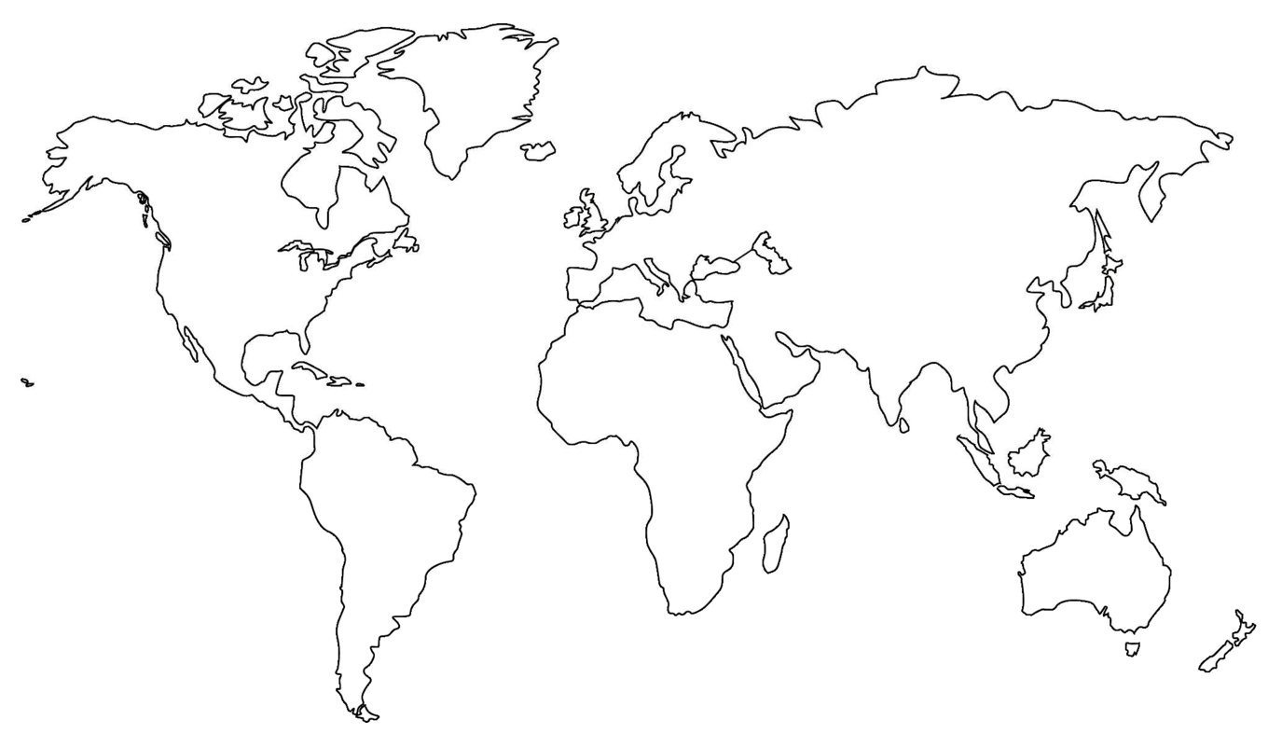

Where are you located?
Stamp Tool
Notes:
Length: 2 minutes for this slide
This slide is a quick demo/practice of the “Stamp” tool and how to use it during course interactions.
Have students Check where they live.
If it’s a small class, have students type their name where they live.
Reach out to the farthest away student

Slide 4


Developer
Patterns & Practices
aka.ms/OfficeDevPnP
aka.ms/OfficeDevPnPYammer

Slide 5
Statistics– Key numbers (previous month)
Forked 282 times (227, 190, 135)
329 merged pull requests (280, 236, 189)
73 closed issues (67, 58, 43)
More than 3776 (2566, 3050, 2160) unique visitors during last 2
Nuget package 4450 downloads (4030, 3800)
Yammer group has 1739 members (1525, 1419, 757)
aka.ms/OfficeDevPnPYammer
Facebook page has 135 likes (121)
https://www.facebook.com/OfficeDevPnP

Slide 6

Thank you for your assistance!
Andrew Connell - @andrewconnell
Eric Skaggs (http://www.catapultsystems.com) - @skaggej
Erwin van Hunen (Knowit AB) - @erwinvanhunen
Gavin Barron - @gavinbarron
Nanddeep Nachan - @NanddeepNachan
Paolo Pialorsi (PiaSys.com) - @PaoloPia
Patrik Björklund (Alloc IT) - @pbjorklund
Robert Skyttberg (@NetRelations) - @robertskyttberg
Radi Atanassov (OneBit Software) - @RadiAtanassov
Tobias Zimmergren (Tozit AB) - @zimmergren
Torsten Schuster
Vardhaman Deshpande (Content and Code) - @vrdmn
MS people – Frank Marasco, Bert Jansen, Jeremy Thake, Vesa Juvonen, Brian Michely, Reeza Ali, Suman Chakrabarti, Ricky Kirkham, Steve Walker

Slide 7
New and updated contributions
New sample Core.UserProfiles.Sync shows how to push user profile properties from Azure AD to the SharePoint user profile store
New sample Core.ODataBatch shows how to perform batching of REST requests
New sample Core.WebPartOnAppWebPage shows how to provision a web part to a app web page by using a module
New sample Provisioning.Hybrid.Simple demonstrates the simplest possible hybrid setup with Azure storage queues, WebJobs and Service Bus relay
New solution Governance.ContentTypeEnforceRetention shows how to create typical retention policy using app model techniques
New solution Governance.SiteUsageReport is a background task that gets data for all site collections in a tenant and sends an email with key statistics like used storage quota, the last content modification date, the count of the webs

Slide 8
Updates to solutions
Updated sample Office365Api.Overview has been completely revamped: it now uses the Office 365 RTM API and a brand new MVC sample application has been added
Updated sample Core.JavaScriptCustomization now properly deals with Minimal Download Strategy (MDS)
Updated sample OD4B.NavLinksInjection now properly deals with Minimal Download Strategy (MDS) and does not show duplicate navigation bars anymore
Updated sample AzureAD.GroupMembership now uses Graph API 2.0 and shows some additional scenarios like getting all
Updated sample Provisioning.SubSiteCreationApp now does applies a custom theme and logo as part of the sub site provisioning
Updated sample Branding.ApplyBranding now supports activation and deactivation of branding
Updated component Core.TaxonomyPicker has improved CSS
Updated solution PowerShell.Commands with additional commands and various other updates. See the changelog of the PowerShell solution for more details

Slide 9
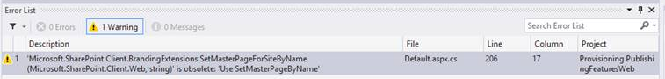
Updates to PnP Core and miscellaneous
Throttling support added across PnP Core library via the ExecuteQueryRetry extension method
All non SharePoint specific extensions are marked as obsolete and will be dropped when we go to v1.0 during the March 2015 update
Cleanup of usings, comments, ...
List permission setting support added
Use XDocument instead of XmlDocument
Improved taxonomy import and export routines
Language agnostic retrieval of page library
Added CredentialManager utility class
Custom actions extensions can now also be used on the Site object (next to the Web object)
Both PnP Core Nuget packages (cloud and on-premises) have been also updated accordingly
Notice. As part of the March release we will remove obsolete methods.

Slide 10
Updates in the Guidance repository
The following articles have been moved over from the PnP guidance:
How to handle OneDrive for Business customization – Vesa Juvonen
How to configure SharePoint Provider-Hosted Apps for distribution – Andrew Connell
How to configure Office 365 API Projects for distribution – Andrew Connell
Following articles have been added:
New: How to deploy Office 365 API samples to Microsoft Azure – Andrew Connell
New: Overview of the new capabilities added per CSOM release – Vesa Juvonen
New : Getting Started with azure WebJobs ("timer jobs") for your Office 365 Sites - Tobias Zimmergren (TOZIT AB) - @zimmergren
New: The guidance of the ECM content pack has been created as articles and sync’d to MSDN
Others coming soon

Slide 11
PnP Core Component moving to v1.0
We target to release v1.0 of the Core component during March master merge
Expected changes
Removal of deprecated methods
Removal of non Office365/SharePoint extensions
Approach towards for v1.0 release
Keep it simple, keep it small
Use class model for complex methods
Use only when truly adds value, no 5 line methods
Unit testing improvements

Slide 12
PnP training
http://aka.ms/OfficeDevPnPTraining
Training based on the PnP material available for anyone to use
Presentations, demos and hands on labs
Introduction to app model
Managing site settings using app model
Branding with app model
Building UX components with app model
Using remote event receivers and remote timer jobs
Site collection and site provisioning
User personalization and OneDrive 4B
ECM capabilities with app model
Using search with app model
Transforming customizations to app model
Download as use as you wish…

Slide 13

Roadmap – March release plan
Starter kits v1.0
Provisioning engine
Remote timer jobs with multi-threading support
Core component v1.0
Removal of deprecated methods
Cleaning
Unit test coverage
Articles
More on the documentation side
Enterprise architect messaging
ALM
Recipes for transformation

Slide 14

Demos, demos, demos!
Vesa - Hybrid simple
Site provisioning from Azure to on-prem
Bert - Core.ODataBatch
REST call batching
Radi - Governance.ContentTypeEnforceRetention
ECM timer jobs

Slide 15
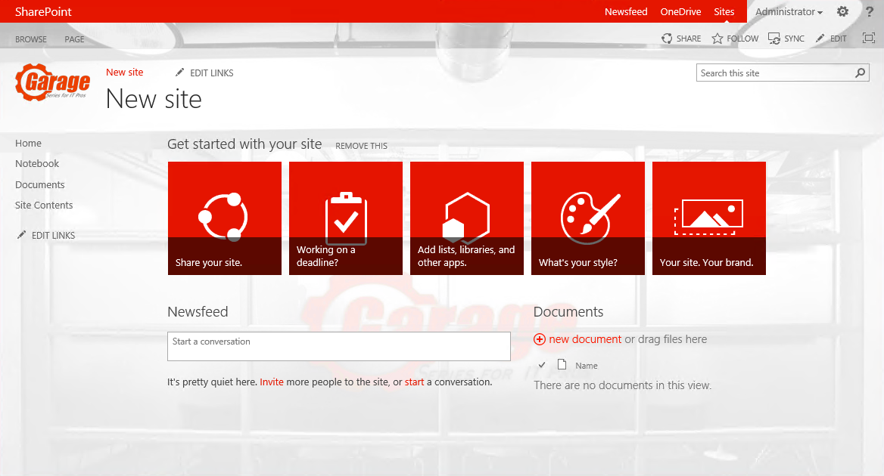
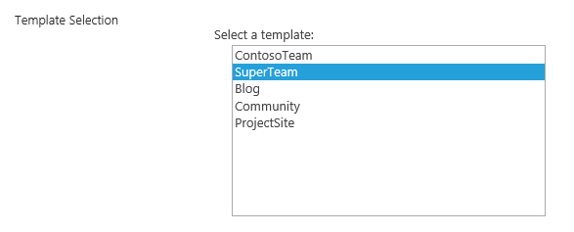
Hybrid provisioning from Azure
Company
SharePoint Farm
2
5
6
1
Storage Queue
Service Bus Relay
https://teams.contoso.com /sites/site
Provider Hosted Apps
WebJob
SharePoint Service
4
3
Based on the end user selection, actual creation of the site collection will be done either to on-premises or to the cloud.
https://contoso.sharepoint.com /sites/site

Slide 16
Feedback…
Please keep the feedback coming in Yammer… we need your input for the prioritization.
Notes:
Priority on planned topics
More code samples
Add core component capabilities
Reusable presentation material
Documentation on patterns and practices for app model (ALM ec.)
More complex solutions
More Office Client apps
More JavaScript app
Length: 30 second for this slide
Instructor notes
The following slides will walk you though the Lync tools that we will use in this class.
You will use all of these tools later in the class
Stress that your students will be able to run much more engaging meetings if they use these tools in their own Lync Meetings.
Course Development Notes:

Slide 17
Transform your code Providing App Model Patterns for common Full Trust Code scenarios
130+ Visual Studio projects Common scenarios
Branding
Site provisioning
Remote event receivers
Large file support
Taxonomy driven navigation
And much more…
Contribute
This is open source project and open for contirbutions
Developer
Patterns & Practices
aka.ms/OfficeDevPnP

Slide 18

Questions?

Slide 19


© 2014 Microsoft Corporation. All rights reserved. Microsoft, Windows, and other product names are or may be registered trademarks and/or trademarks in the U.S. and/or other countries.
The information herein is for informational purposes only and represents the current view of Microsoft Corporation as of the date of this presentation. Because Microsoft must respond to changing market conditions, it should not be interpreted to be a commitment on the part of Microsoft, and Microsoft cannot guarantee the accuracy of any information provided after the date of this presentation. MICROSOFT MAKES NO WARRANTIES, EXPRESS, IMPLIED OR STATUTORY, AS TO THE INFORMATION IN THIS PRESENTATION.

